Slide 1
Linear Regression with Variable Selection
Week 3

Slide 2
FEATURE Selection

Slide 3
Feature Selection Algorithms
WRAPPER APPROACH
Classifier accuracy: i.e. put a classifier and test the classification performance using the different feature subsets
Select the one that maximizes the accuracy
FILTER APPROACH
Another approach is to evaluate the subsets in terms of their information content, relevance, statistical dependence, their interclass distance or their estimate of classification error
EMBEDDED APPROACH
The FS process is integrated with the classification process. Example includes Decision Tree construction (evaluates each feature and selects the high score feature to start the tree). Recently Random Forest also has an effective measure of relevance of a feature.

Slide 4
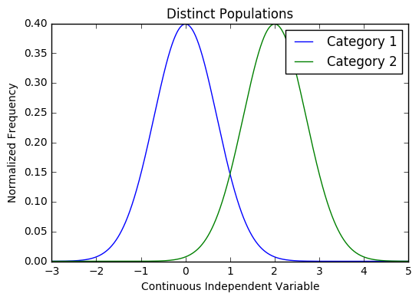
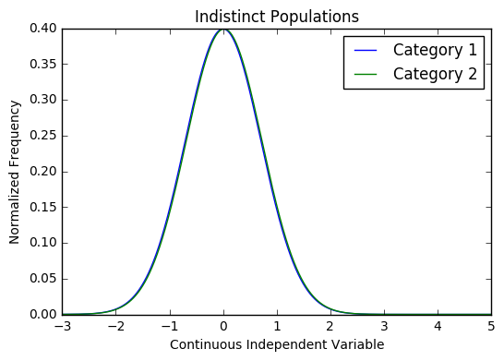
Feature Selection: Filter Methods
When the outcome variable is categorical and the input variable is
continuous, we can quickly check on statistical significance of differences
in the distribution of the continuous variable for different values of the
categorical outcome

Slide 5
Feature Selection: Filter Methods
Mutual Information
Measures if a set of features share information with the class.
For multi-class we can sum over all classes.
A good measure is also to use mutual information to measure relevance to the class as above but also to reduce relevance of the features to each other.
We can select our features from feature space by ranking their mutual information with the target variable.
Advantage of using mutual information over F-Test is, it does well with the non-linear relationship between feature and target variable.
Sklearn offers feature selection with Mutual Information for regression and classification tasks.
sklearn.feature_selection.mututal_info_regression sklearn.feature_selection.mututal_info_classif

Slide 6
Feature Selection: Filter Methods
Variance Threshold
This method removes features with variation below a certain cutoff.
The idea is when a feature doesn’t vary much within itself, it generally has very little predictive power.
sklearn.feature_selection.VarianceThresholdVariance
Threshold doesn’t consider the relationship of features with the target variable.
In the assignment we will look at the Feature Selection module of the sklearn package.
General Note: it is a good practice to scale and normalize quantitative features so that they lie within the same interval on the real line. This makes fitting programs more efficient.

Slide 7
Feature Selection: Wrapping Methods
Wrapper Methods generate models with a subsets of feature and gauge their model performances.
Forward Search
This method allows you to search for the best feature w.r.t model performance and add them to your feature subset one after the other.
Feature 3
Feature 2
Feature 3
Feature 1

Slide 8
Feature Selection: Wrapping Methods
Recursive Feature Elimination
As the name suggests, this method eliminates worst performing features on a particular model one after the other until the best subset of features are known.
Feature 1
Feature 2
Feature 3
Feature 5
Feature 1
Feature 2
Feature 4
Feature 5

Slide 9
Feature Selection: Wrapping Methods
Recursive Feature Elimination
As the name suggests, this method eliminates worst performing features on a particular model one after the other until the best subset of features are known.

Slide 10
Recursive Feature Elimination
RFE recursively eliminates variables from consideration depending on their performance relative to an estimator.
For example, if the estimator is a linear regression, the linear coefficient of the regression may be used rank potential predictors according to their strength of their predictive power for the outcome (dependent variable)
The estimator is trained on the data and the least important features(or most important) are removed, based on the ranking
The estimator is then trained again, in a recursive fashion, on the data, until only the desired number of predictors is retained.
A “cross validation” set should be used to select the desired number of features in addition to training set and test set as a best practice.
Cross Validation will be covered in the week 7 lecture: Hyperparameters, Regularization and Cross Validation. For now, the cross validation set can be thought of as the test set that we used in the previous lab exercise to estimate r-squared on unseen data, when the model was fit to our training set.

Slide 11
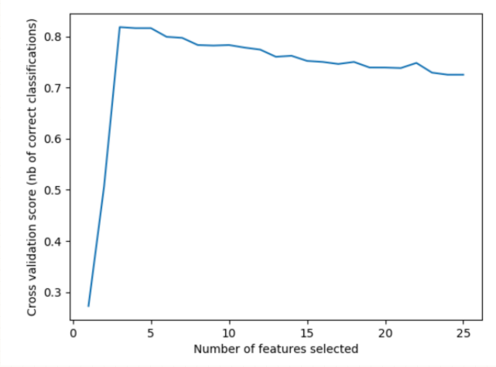
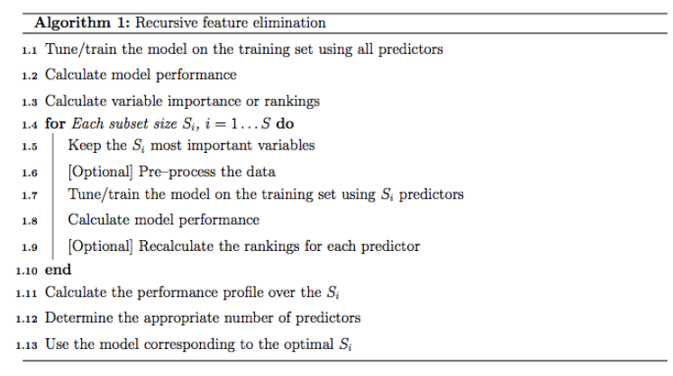
Assignment 4
odel
The y axis could also be R-squared
The value would peak and fall off
on the test set
as the featured increased
in the case of over-fitting
Source: Sklearn documentation for RFECV
Plotting the r-squared value (or other performance metric) of the model fit for each subset of model parameters at each step of the algorithm shows which subset of parameters best predicts unseen data.
Caveat: feature selection can be challenging for “sparse” datasets with many model coefficients (or other ranking metric) close to 0 because optimization algorithms will not usually converge to exact “0” values and many non-negative effects.can cancel each other out. Multicollinearlity can also cause model coefficients, and therefor feature rankings in this algorithm, to be unstable. In these cases, more complex feature elimination methods are required. There is current research in this area. Here, we introduce the basic concept with a working example.

Slide 12
Recursive Feature Elimination
from sklearn.feature_selection import RFE
Estimator is a supervised learning estimator with a fit method that provides information about the importance of the features either as a coefficient (as with linear regression) or as a feature importance attribute (decision trees)
n-features to select: the number of features to select for the final model
Step: the number (or percentage) of features to remove at each step
class sklearn.feature_selection.RFE(estimator, n_features_to_select=None, step=1, verbose=0)
Source: http://scikit-learn.org/stable/modules/generated/sklearn.feature_selection.RFE.html#sklearn.feature_selection.RFE

Slide 13
Recursive Feature Elimination with Cross Validation- sklearn
class sklearn.feature_selection.RFECV(estimator, step=1, cv=None, scoring=None, verbose=0,
n_jobs=1)
from sklearn.feature_selection import RFECV
cv determines the cross validation strategy, with the default being a 3-way split of the data (X, y) supplied to the fit method e.g. (refer to user guide for alternative strategies)
Selector = RFECV(estimator,step=1)
Selector.fit(X,y)
Instead of choosing the number of features for the final model, as with RFE (n_features_to_select), the number of features is chosen based on optimized performance on the cross validation set
Source: http://scikit-learn.org/stable/modules/generated/sklearn.feature_selection.RFE.html#sklearn.feature_selection.RFE

Slide 14
Feature Selection: Embedded Methods
Feature selection can also be achieved by the insights provided by some Machine Learning models.
Tree based models calculates feature importance for they need to keep the best performing features as close to the root of the tree. Constructing a decision tree involves calculating the best predictive feature.
The feature importance in tree based models are calculated based on Gini Index, Entropy or Chi-Square value.

Slide 15
Filters, Wrappers or Embedded
Filters
Pros:
independent of the learning algorithm
low complexity and therefore good for large number of features
Cons:
selects larger subsets
Wrappers
Pros:
better accuracy as they are tied to the classifier
subset selection is tune to the learning algorithm (limit the generalization unless it uses good training practice)
Cons:
more complex and can be slow
dependent on the learning algorithm

Slide 16
Filters, Wrappers or Embedded
Embedded
Pros:
performance competitive with wrapper
fast learning
Cons:
tied to the learning process

Slide 17
Linear Regression

Slide 18
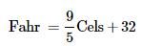
Simple Linear Regression
Simple linear regression is a statistical method that allows us to summarize and study relationships between two continuous (quantitative) variables:
One variable, denoted x, is regarded as the predictor
The other variable, denoted y, is regarded as the response
Different types of relationships between two variables (you can generalize these definitions to any arbitrary set variables):
deterministic (or functional) relationships: when there is a mathematical function that defines y based on x. For example, the relation between Fahrenheit and Celsius is
or the relation between Circumference and diameter of a circle is

Slide 19
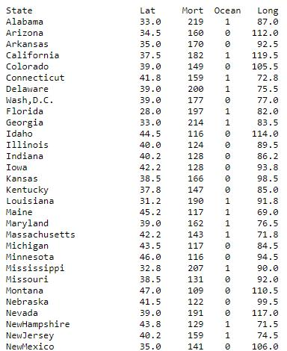
Simple Linear Regression
statistical relationships : when there is not mathematical formula (function) that relates y to x.
Example for statistical relation: Consider the following data set in which
the Mort variable is the mortality due to
skin cancer (number of deaths per 10
million people) and the lat variable is
the latitude of the center of each state.
We consider Mort as y, response, and lat
as x, predictor. Let’s plot Mort vs lat(next
slide)

Slide 20
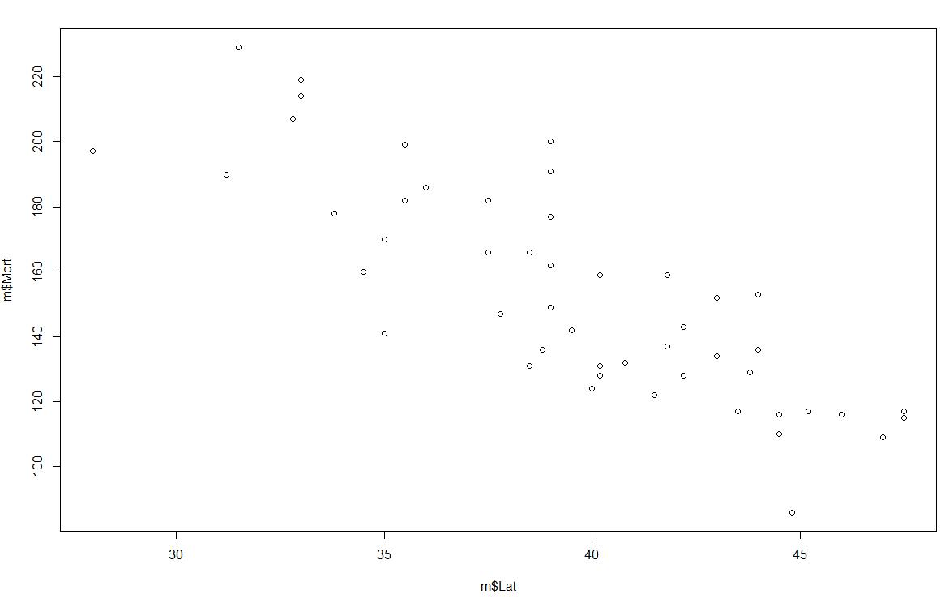
Simple Linear Regression
As you can see, there is not any functional relation between y and x here.
In other words, if you connect the data points, you would not get a graph of a well-defined function (or it is very difficult to find that function)

Slide 21
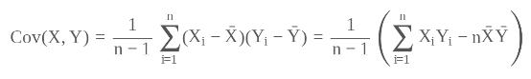
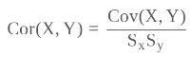
Simple Linear Regression
In the case where we are dealing with statistical relation, we need to use statistical methods to estimate a mathematical relation that best fit the data set (can describe the data set in an efficient way)
Let be the sample that we observe by conducting an experiment. We define the covariance of Y and x to be
We define the correlation of Y and x to be

Slide 22
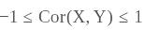
Simple Linear Regression
Fact: .
In general, we have two types of statistical relations:
Linear relation: If Cor(Y,X) is close to 1, it means that we have a positive linear relation (The slop is positive). If Cor(Y,X) is close to -1, it means that we have a negative linear relation.
Non-linear relation: If Cor(Y,X) is close to zero, it means that we do not have any linear relation.

Slide 23
Simple Linear Regression
Example of Linear Relation (decreasing): cor(y,x)=-0.824

Slide 24
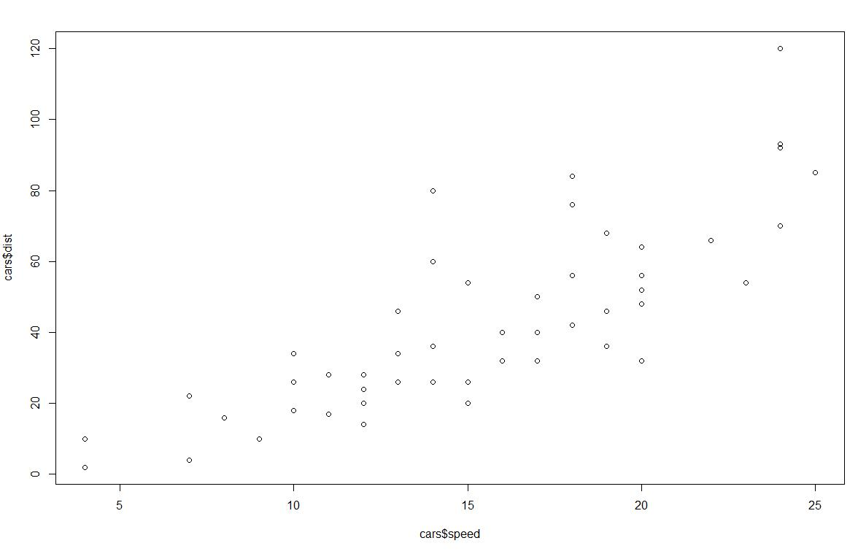
Simple Linear Regression
Example of Linear Relation (increasing): cor(y,x)=0.8

Slide 25
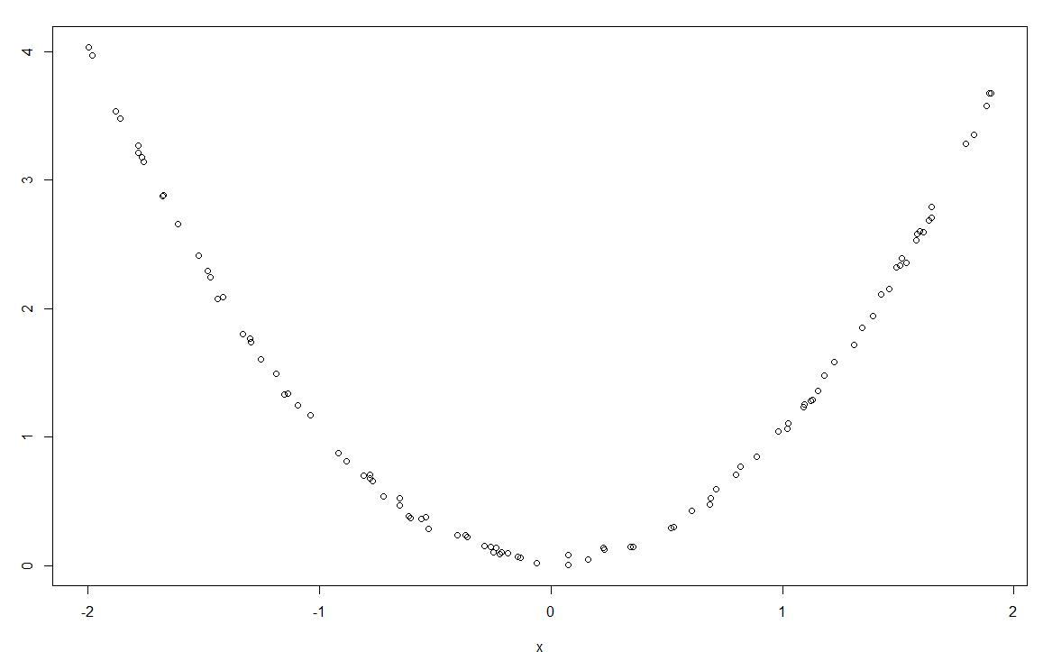
Simple Linear Regression
Example of None-Linear Relation: cor(y,x)=-0.023

Slide 26
Simple Linear Regression
Suppose we conduct an experiment and in this experiment we have two variables, y and x. Suppose that y depends on x and y has a linear relation with x (cor(x,y) is close to 1 or -1). Since y has a linear relation with x, we can find an equation of a line that can describe our data set.
The line that can describe our data set in the most efficient way is called linear regression line or model. If the line is describing the relation between two variables (y and x), it is called simple linear regression model or line.

Slide 27
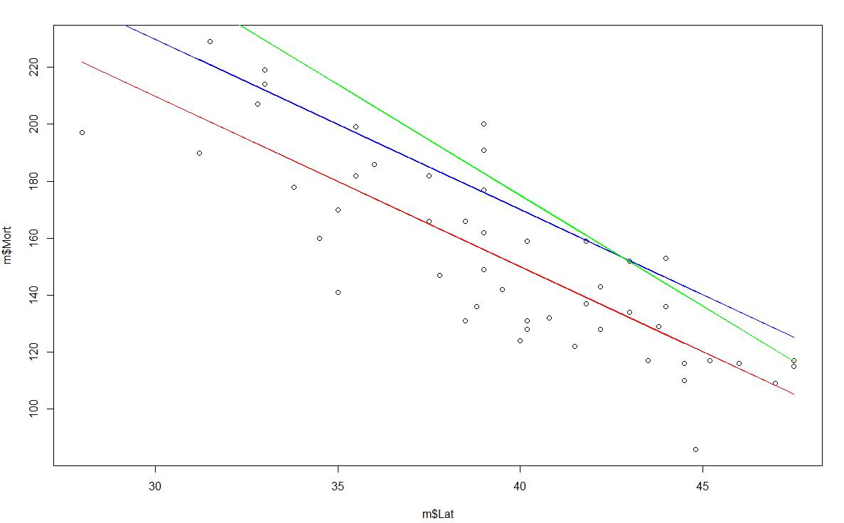
Simple Linear Regression
Example: The best line is the red one.

Slide 28
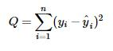
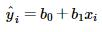
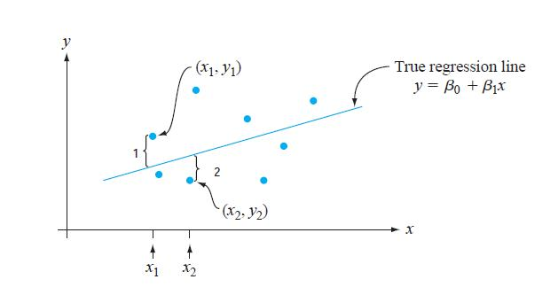
Simple Linear Regression
How to find the best fitted line?
Suppose
We are looking for a line , , such that
is minimum where is the predicted response.

Slide 29
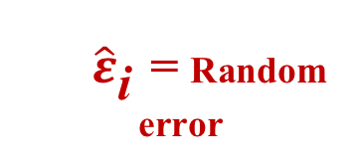
Sample Linear Regression Model
y
$\hat{ε}$_{i} = Random error
^
Unsampled observation
Observed value
x
Observed value

Slide 30
Least Squares
‘Best fit’ means difference between actual y values and predicted y values are a minimum
But positive differences off-set negative
Least Squares minimizes the Sum of the Squared Differences (SSE)

Slide 31
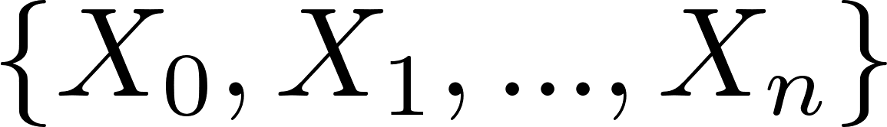
Multivariable regression
Now assume instead of having one variable as predictor we have a set of variables such as . Then the regression model is
that we call a multivariable regression model.
The method to find the best fitted multivariable regression is similar to simple regression. In other words, we need to minimize the distance between the predicted values and the actual values.

Slide 32
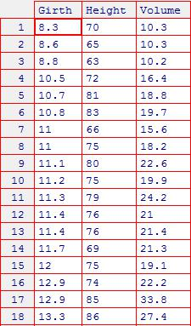
Multivariable regression
Example: We have a data set in which there are 3
variables describing different features of cherry
trees:
Girth: tree diameter in inches (denoted x1)
Height: tree height in feet (x2).
Volume: volume of the tree in cubic feet. (y)
Let Y=volume and the predictors be Girth and
Height.

Slide 33
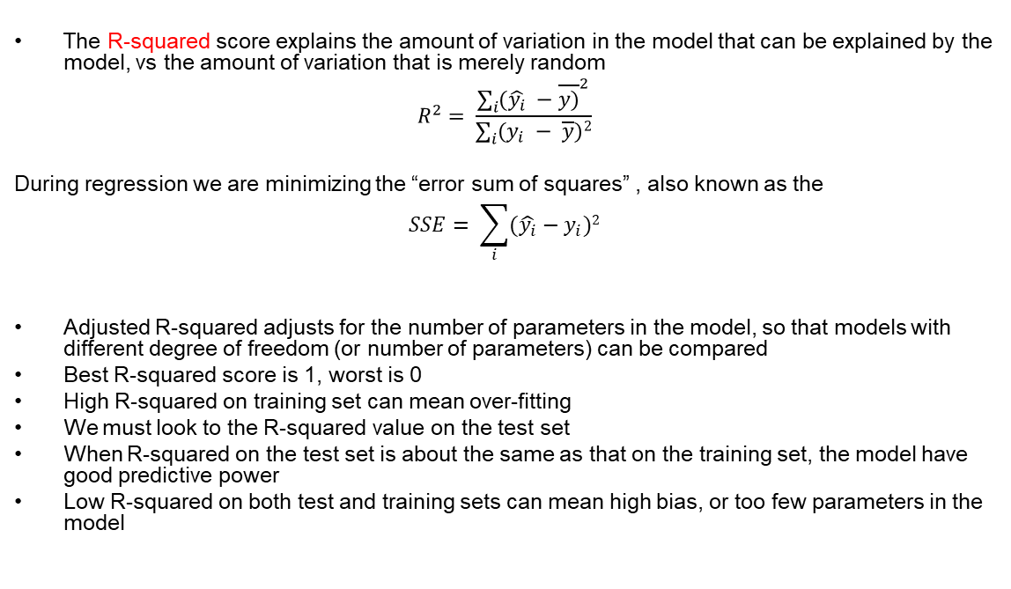
R-squared vs Square Errors
Variation from model
Total variation

Slide 34
Multicollinearity
Multicollinearity arises when two variables that measure the same thing or similar things (e.g., weight and BMI) are both included in a multiple regression model; they will, in effect, cancel each other out and generally destroy your model.

Slide 35
Lab Activity

